Slide 1

EFFICIENT CUSTOMER ACCOUNT RETRIEVAL USING HASH TABLE
PRESENTD BY RAKSHANA S(192521165)

Slide 2
PROBLEM STATEMENT
A banking system manages millions of customer records. Customers expect their account details to be retrieved instantly using their account number. Therefore, the
system requires a data structure that provides fast, accurate, and efficient search operations.
OBJECTIVE
Select the most suitable data structure for retrieving customer account details quickly and efficiently.

Slide 3


DATA STRUCTURE SELECTION
SELECTED DATA STRUCTURE: HASH TABLE
REASONS:
Uses account number as the key.
Provides direct access to records.
Fast and efficient searching.
Suitable for large banking databases.

Slide 4
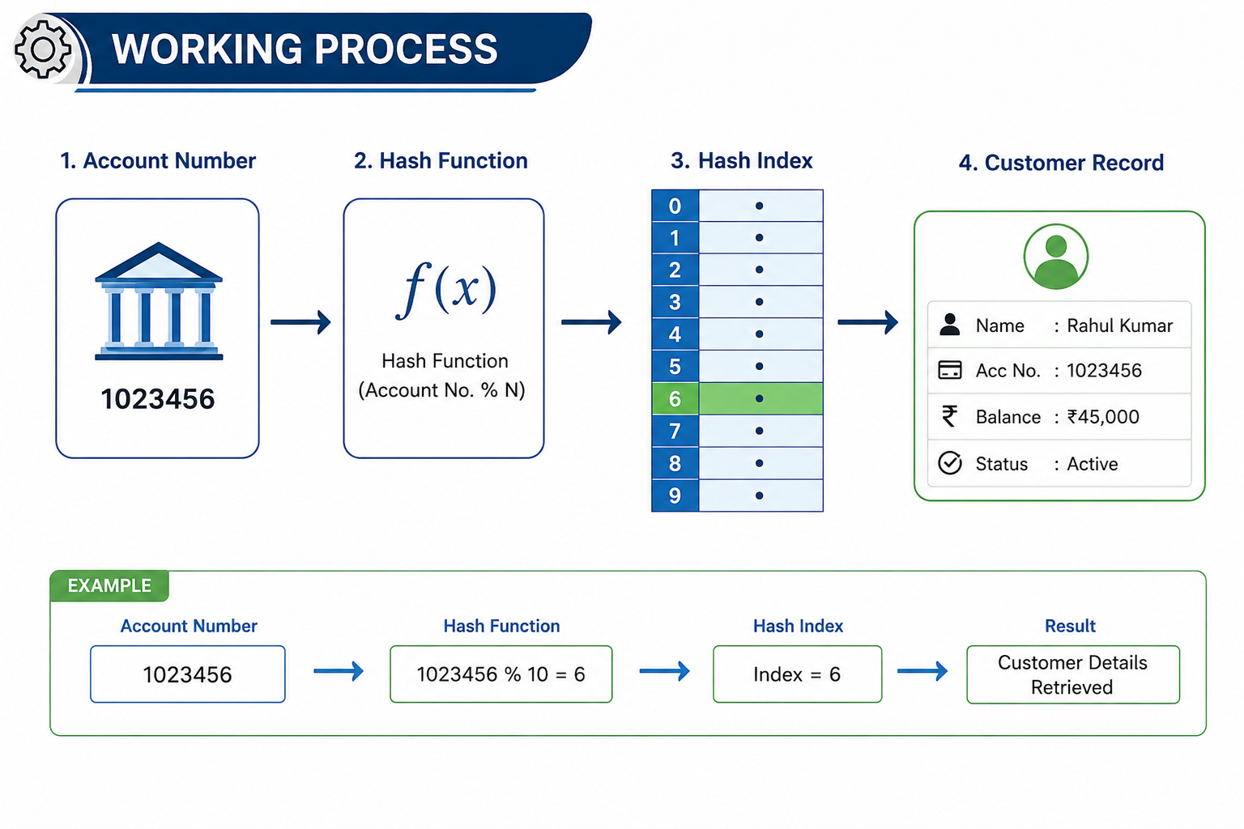
HOW HASH TABLE WORKS

Slide 5
WHY HASH TABLE
ADVANTAGES
Average search time O(1) Instant account retrieval
Fast insertion and deletion
Handles millions of records efficiently

Slide 6
PERFORMANCE COMPARISON
Data Structure | Search Time
Array | O(n)
Linked List | O(n)
Binary Search Tree | O(log n)
Hash Table | O(1)

Slide 7
CONCLUSION
Banking requires quick customer lookup.
Hash Table provides the fastest average search.
Improves system efficiency and scalability.
Best choice for customer account retrieval

Slide 8
REFERENCES
Reema Thareja, Data Structures Using C, Oxford University Press.
Mark Allen Weiss, Data Structures and Algorithm Analysis in C, Pearson Education.
Thomas H. Cormen, Charles E. Leiserson, Ronald L. Rivest, and Clifford Stein, Introduction to Algorithms (CLRS), MIT Press.
Seymour Lipschutz, Data Structures, Schaum's Outline Series.
Ellis Horowitz, Sartaj Sahni, and Susan Anderson-Freed, Fundamentals of Data Structures in C, Universities Press.
Robert Lafore, Data Structures and Algorithms in C++, SAMS Publishing.

Slide 9
THANK YOU

